Slide 1
Fusing global attention and self-attention for better performance and interpretability on tabular data
賴俊延
指導教授:郭炤裕老師、林逸芬老師
Bui, H., & Le, B. (2025). Expert Systems with Applications, 130220.

Slide 2
Outline
Background
Motivation
Methods

Slide 3
Background
Vaswani, A., Shazeer, N., Parmar, N., Uszkoreit, J., Jones, L., Gomez, A. N., ... & Polosukhin, I. (2017). Attention is all you need. Advances in neural information processing systems, 30.

Slide 4

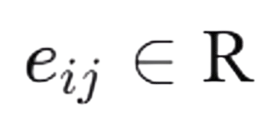
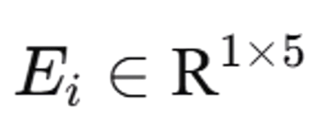
Embedding
Background
E
X1
e11
e12
e13
e14
e15
E1
X2
e21
e22
e23
e24
e25
E2
X3
e31
e32
e33
e34
e35
E3
X4
e41
e42
e43
e44
e45
E4
X5
e51
e52
e53
e54
e55
E5
Vaswani, A., Shazeer, N., Parmar, N., Uszkoreit, J., Jones, L., Gomez, A. N., ... & Polosukhin, I. (2017). Attention is all you need. Advances in neural information processing systems, 30.

Slide 5
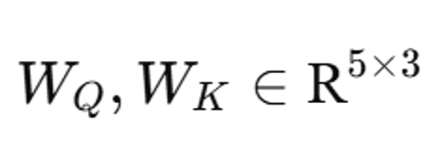
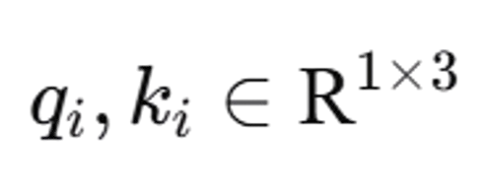
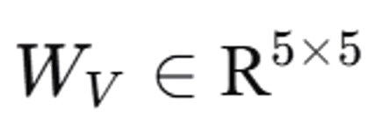
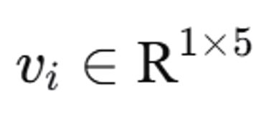
Query, Key & Value
Background
q1
q2
q3
E
Wq
Q
q4
q5
k1
k2
E
Wk
K
k3
k4
v1
k5
v2
E
Wv
V
v3
Vaswani, A., Shazeer, N., Parmar, N., Uszkoreit, J., Jones, L., Gomez, A. N., ... & Polosukhin, I. (2017). Attention is all you need. Advances in neural information processing systems, 30.
v4
v5

Slide 6
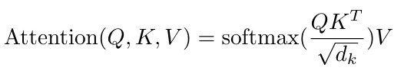
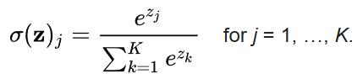
Attention (1)
Background
Vaswani, A., Shazeer, N., Parmar, N., Uszkoreit, J., Jones, L., Gomez, A. N., ... & Polosukhin, I. (2017). Attention is all you need. Advances in neural information processing systems, 30.
(Wikipedia)
q1
q1k1
q1k2
q1k3
q1k4
q1k5
q2
q2k1
q2k2
q2k3
q2k4
q2k5
q3
k1
k2
k3
k4
k5
q3k1
q3k2
q3k3
q3k4
q3k5
q4
q4k1
q4k2
q4k3
q4k4
q4k5
q5
q5k1
q5k2
q5k3
q5k4
q5k5
Vaswani, A., Shazeer, N., Parmar, N., Uszkoreit, J., Jones, L., Gomez, A. N., ... & Polosukhin, I. (2017). Attention is all you need. Advances in neural information processing systems, 30.

Slide 7
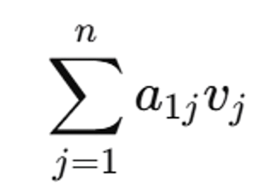
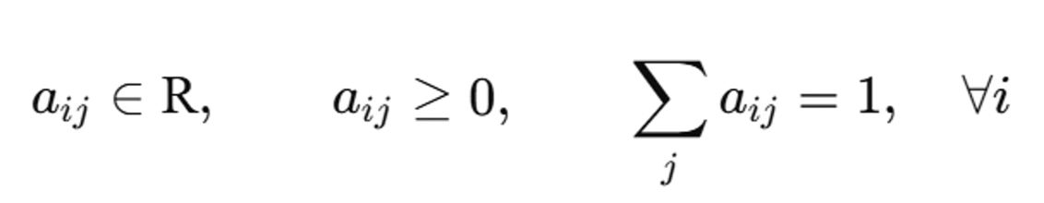
Attention (2)
Background
a11
a12
a13
a14
a15
v1
a21
a22
a23
a24
a25
v2
a31
a32
a33
a34
a35
v3
.
.
.
a41
a42
a43
a44
e45
v4
a51
a52
a53
a54
a55
v5
Vaswani, A., Shazeer, N., Parmar, N., Uszkoreit, J., Jones, L., Gomez, A. N., ... & Polosukhin, I. (2017). Attention is all you need. Advances in neural information processing systems, 30.

Slide 8
Concept
Background
I
Iike
you
Q、K space
Embedding
Attention
V、Shift
Vaswani, A., Shazeer, N., Parmar, N., Uszkoreit, J., Jones, L., Gomez, A. N., ... & Polosukhin, I. (2017). Attention is all you need. Advances in neural information processing systems, 30.

Slide 9
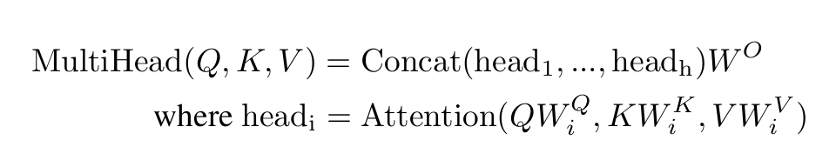
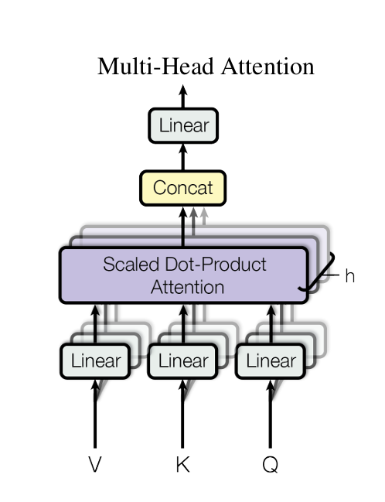
Muti-Head Attention
Background
W : Matrix of a linear transformation
Vaswani, A., Shazeer, N., Parmar, N., Uszkoreit, J., Jones, L., Gomez, A. N., ... & Polosukhin, I. (2017). Attention is all you need. Advances in neural information processing systems, 30.

Slide 10
Motivation
Bui, H., & Le, B. (2025). Expert Systems with Applications, 130220.

Slide 11

Why Deep Learning Struggles with Tabular Data
Motivation
Heterogeneous Feature Space
  Composed of diverse data types (continuous, categorical, and ordinal) drawn from entirely different distributions.
  No inherent spatial or sequential structure, unlike images or text.
Arbitrary Column Ordering
  Column order carries no semantic meaning.
  Models must be strictly permutation-equivariant to yield consistent outputs.
height | blood type | Pain intensity
170 | A | Mild
180 | B | moderate
155 | O | severe
160 | AB | severe
Image source : https://reurl.cc/5XRxpn
Bui, H., & Le, B. (2025). Expert Systems with Applications, 130220.

Slide 12
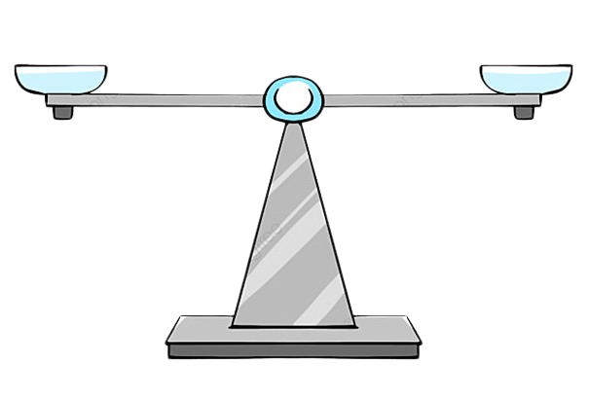
The Interpretability and Robustness Gap
Motivation
The "Black-Box" Adoption Barrier
  Although deep learning matches tree-based SOTA models (e.g., GBDTs), real-world adoption is limited by a lack of transparency.
  Current attention-based solutions often fail to balance model capacity with clear, dual-level explanations.
Performance
Interpretability
Bui, H., & Le, B. (2025). Expert Systems with Applications, 130220.
Image source : Pngtree

Slide 13
Unifying Local and Global Perspectives
Motivation
Dual Structure of Tabular Patterns
  Local Level: Instance-specific, fine-grained feature interactions unique to individual samples.
  Global Level: Dataset-wide, population-level statistical dependencies consistent across all samples.
The Research Gap
  Integrating multi-scale (local and global) attention in tabular learning remains underexplored.
  Traditional methods process attention independently, missing cross-scale interactions.
Local
Global
Cross-Attention Fusion
Bui, H., & Le, B. (2025). Expert Systems with Applications, 130220.

Slide 14
Methods
Bui, H., & Le, B. (2025). Expert Systems with Applications, 130220.

Slide 15


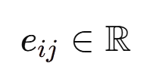

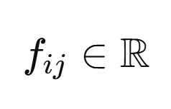
Feature embedding block
Methods
e11
e12
e13
e14
e15
X1 : gender(male, female)
X2 : city(Taipei,Taichung, Kaohsiung)
e21
e22
e23
e24
e25
e31
e32
e33
e34
e35
e41
e42
e43
e44
e45
e51
e52
e53
e54
e55
e61
e62
e63
e64
e65
e71
e72
e73
e74
e75
| VK | : Number of categories for the variable
SK : Special codes such as UNK or MISS
if(c) : The identifier of this category within its associated variable
f11
f12
f13
f14
f15
f21
f22
f23
f24
f25
Bui, H., & Le, B. (2025). Expert Systems with Applications, 130220.

Slide 16
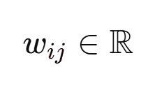

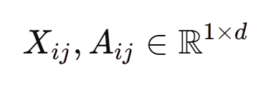
Feature embedding block (2)
Methods
Standardize(X3 : height)
w11
w12
w13
w14
w15
e11
e12
e13
e14
e15
Standardize(X4 : weight)
w11
w12
w13
w14
w15
e11
e12
e13
e14
e15
X1
A1
X2
A2
permutation-equivariant :
X2
A2
X1
A1
Attn
Attn
X3
A3
X5
A5
P : permutation matrix
X4
A4
X4
A4
X5
A5
X3
A3
Bui, H., & Le, B. (2025). Expert Systems with Applications, 130220.

Slide 17
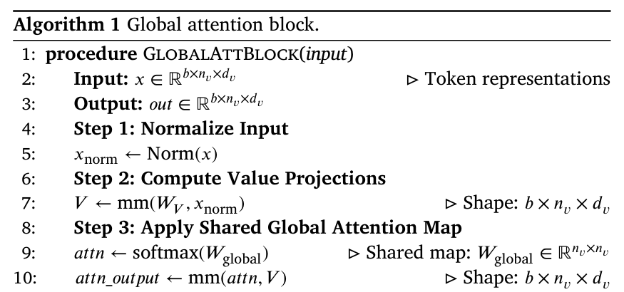


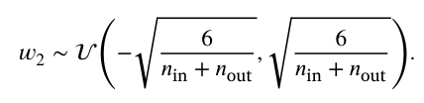
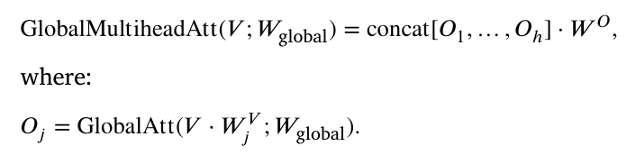


Global attention layer
Methods
Initialization strategy:
Step 2 & 3:
Norm :
mm : matrix multiplication
b: Batch size
nv : Number of features
dv : embedding dimension
(pytorch documentation)
Bui, H., & Le, B. (2025). Expert Systems with Applications, 130220.

Slide 18
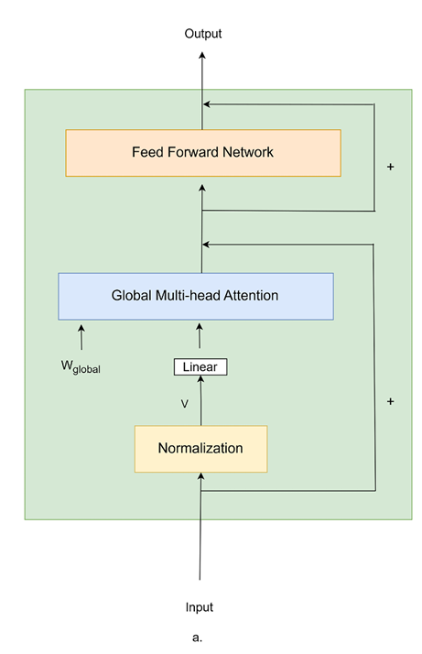
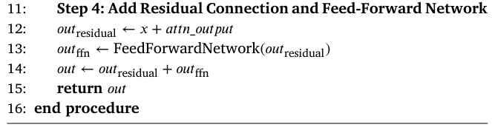
Global attention layer (2)
Methods
Bui, H., & Le, B. (2025). Expert Systems with Applications, 130220.

Slide 19
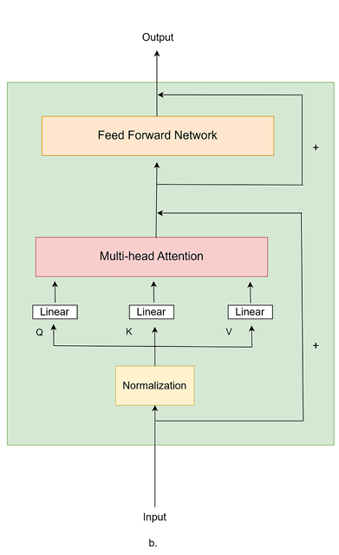
Local attention layer
Methods
W : Matrix of a linear transformation
Vaswani, A., Shazeer, N., Parmar, N., Uszkoreit, J., Jones, L., Gomez, A. N., ... & Polosukhin, I. (2017). Attention is all you need. Advances in neural information processing systems, 30.
Bui, H., & Le, B. (2025). Expert Systems with Applications, 130220.

Slide 20
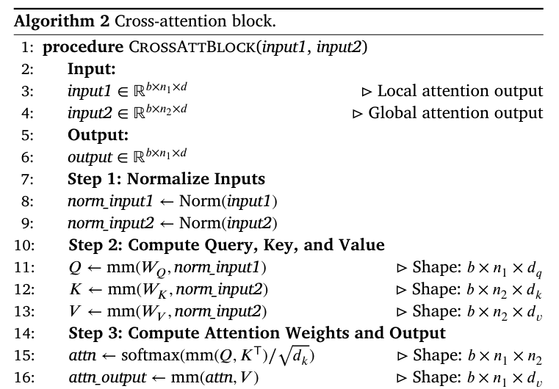


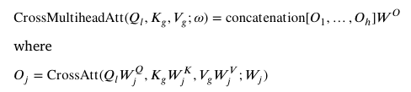
Cross-attention layer
Methods
Step 2 & 3:
Ql : Query obtained from the local attention layer
Kg : Key obtained from the global attention layer
Vg : Value obtained from the global attention layer
W : Matrix of a linear transformation
mm : matrix multiplication
b: Batch size
n : Number of features
d : embedding dimension
Bui, H., & Le, B. (2025). Expert Systems with Applications, 130220.

Slide 21
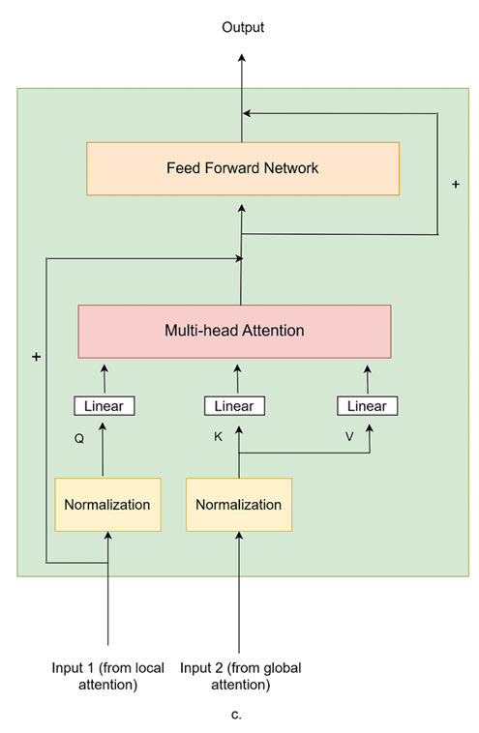
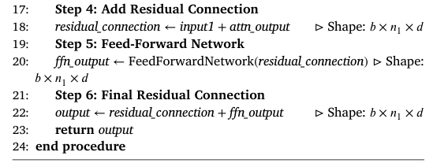
Cross-attention layer (2)
Methods
Bui, H., & Le, B. (2025). Expert Systems with Applications, 130220.

Slide 22
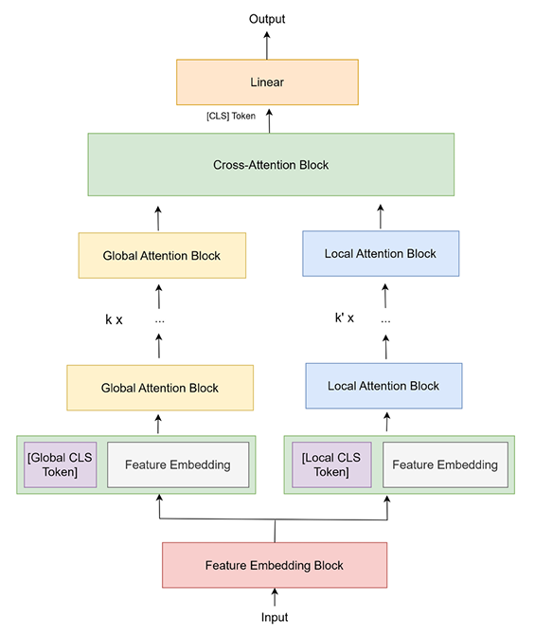
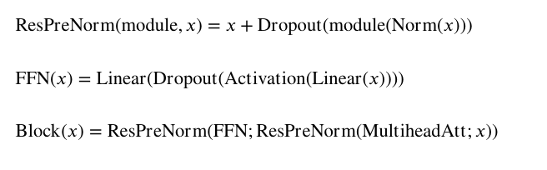
Architecture
Methods
Block :
Input
X + Dropout(Multihead(Norm(X))) = X*
FNN(X*) = Linear(Dropout(Activation(Linear(X*)))) = X**
X* + Dropout(X**) = X***
Output
Bui, H., & Le, B. (2025). Expert Systems with Applications, 130220.
CLS is a learnable vector; it is not part of the embeddings of the original variables.

